Slide 1

Should you have any prior experience before taking the Solution Architect Associate certification?

Slide 2
How long should you prepare?

Slide 3
Which courses/resources did I use?

Slide 4
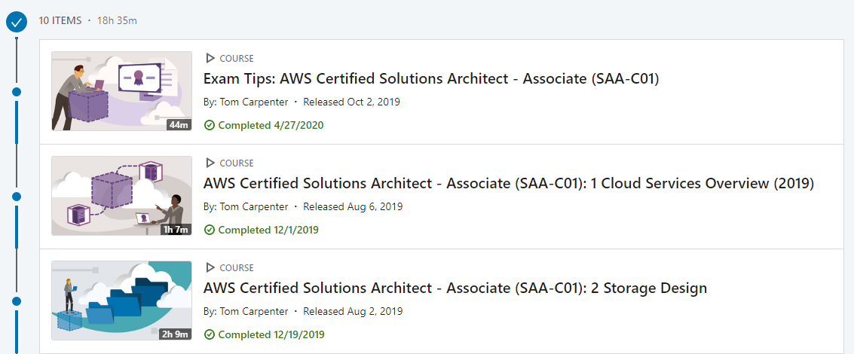

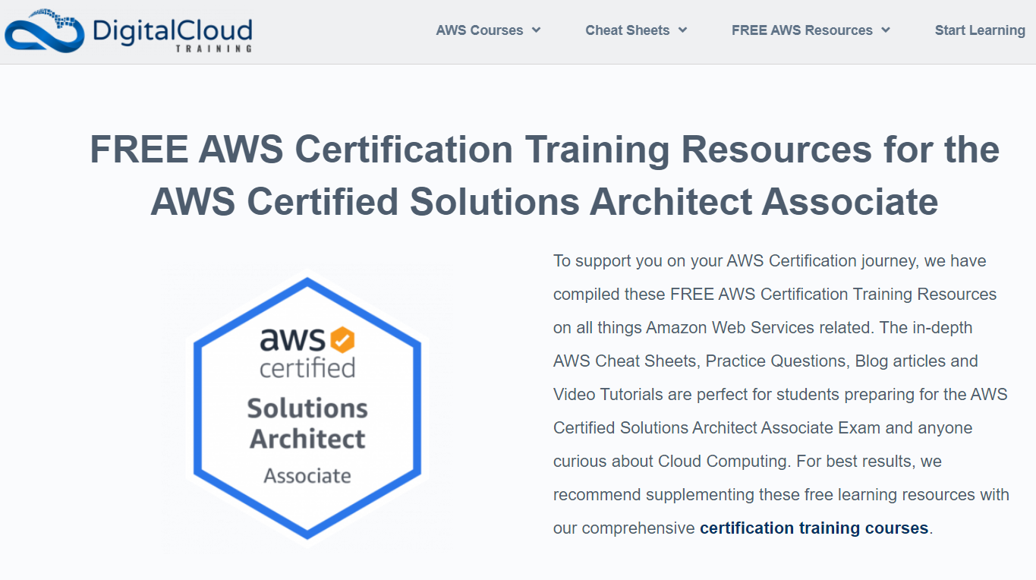
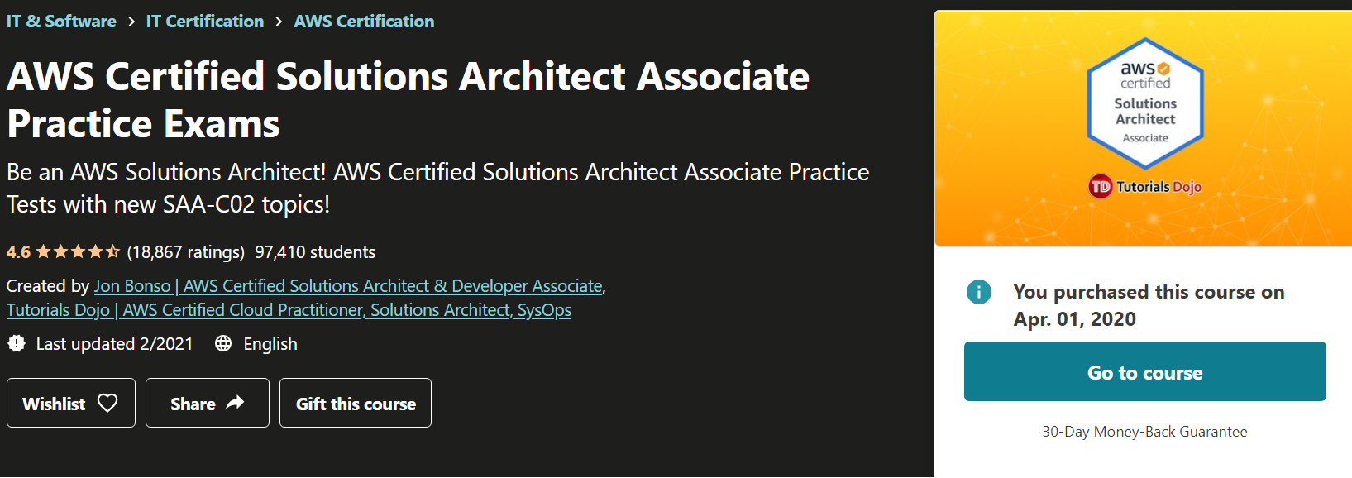

Slide 5
If I started over, what would I do differently?

Slide 6
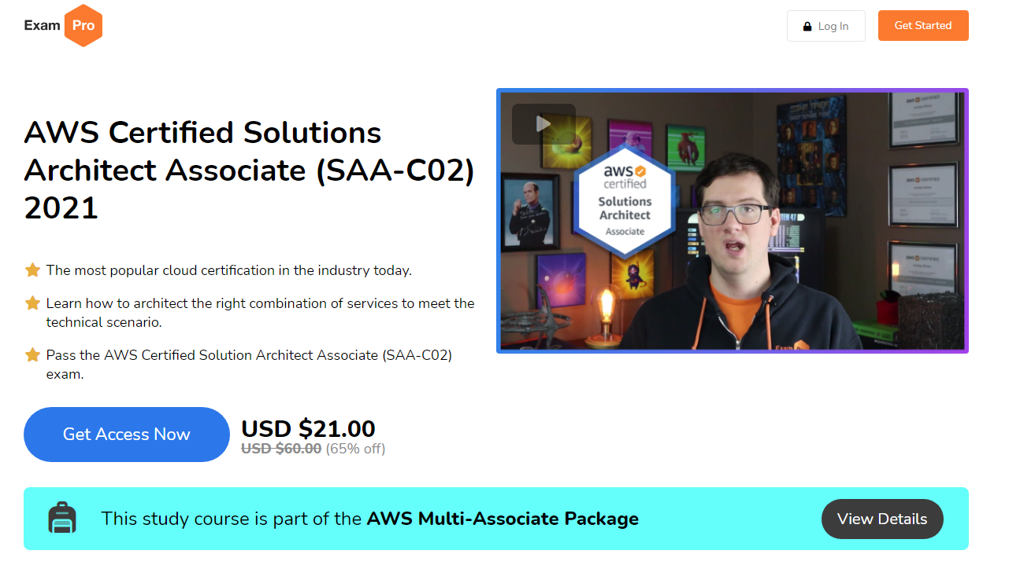
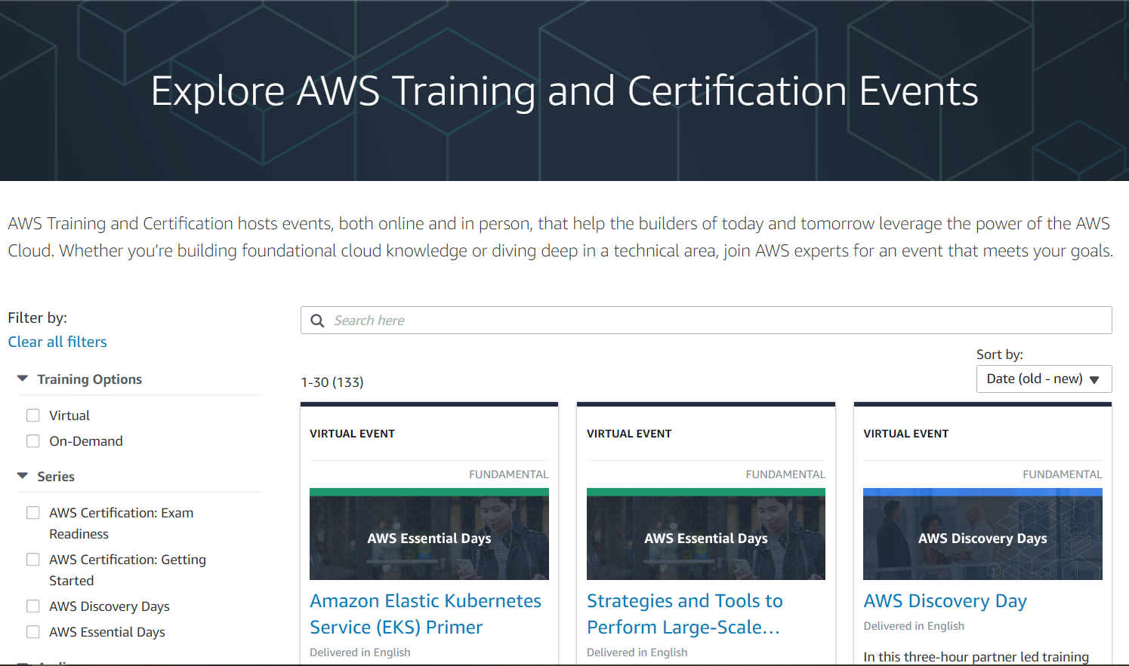
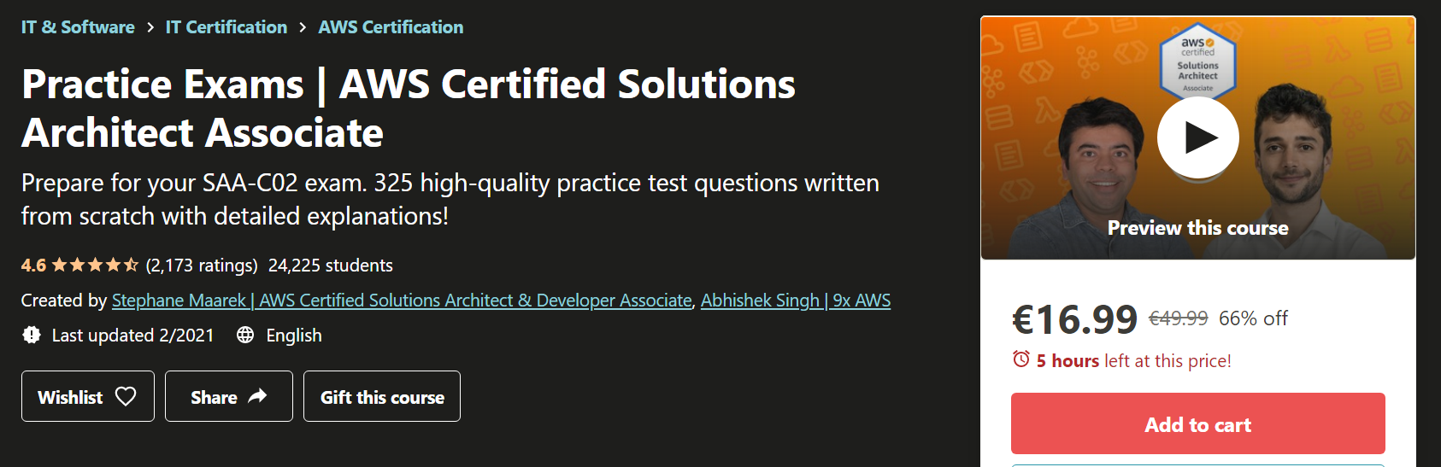
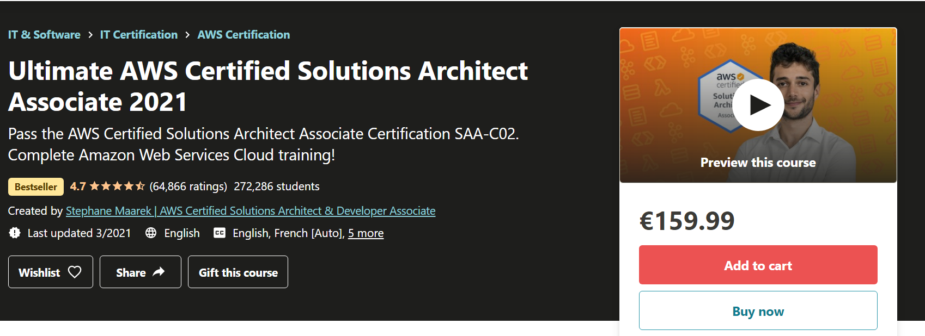

Slide 7
Links:
https://aws.amazon.com/training/events/?th=tile&tile=ways&get-certified-vilt-courses-cards.sort-by=item.additionalFields.startDateSort&get-certified-vilt-courses-cards.sort-order=asc
https://www.youtube.com/watch?v=Ia-UEYYR44s
https://digitalcloud.training/amazon-aws-free-certification-training-developer-associate/
https://www.udemy.com/course/aws-certified-solutions-architect-associate-amazon-practice-exams-saa-c02/
https://www.udemy.com/course/aws-certified-solutions-architect-associate-saa-c02/
https://www.udemy.com/course/practice-exams-aws-certified-solutions-architect-associate/
https://d1.awsstatic.com/training-and-certification/docs-sa-assoc/AWS-Certified-Solutions-Architect-Associate_Sample-Questions.pdf

